Slide 1
Machine Learning
Parameswari Etiiappan

Slide 2
Data Science – A Definition
Data Science is the science which uses computer science, statistics and machine learning, visualization and human-computer interactions to collect, clean, integrate, analyze, visualize, interact with data to create data products.

Slide 3
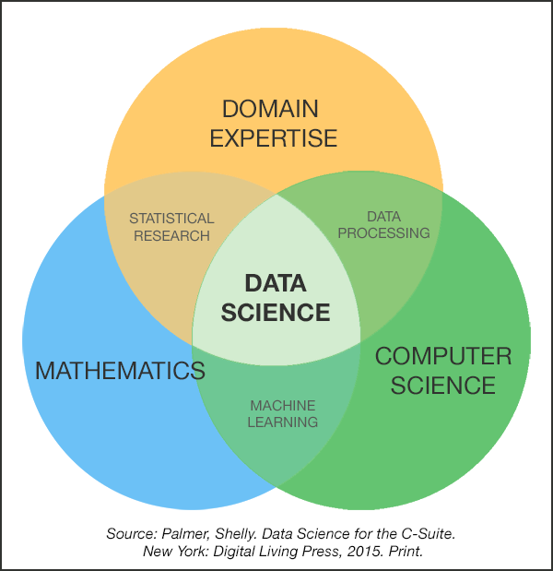
Data Science

Slide 6
Data Science and Others
Business Intelligence
Statistics
Data(base) Management
Visualization
Machine Learning
Data Mining
Artificial Intelligence
Big Data

Slide 8
Big Data Science Tasks
Facebook
Amazon
Google
LinkedIn
Netflix
Rozetka
Microsoft

Slide 9
Regular Data Science Tasks
Data analysis
What percentage of users back to our site?
Which products usually bought together?
Modeling/statistics
How many cars we are going to sell next year?
Which city is better for opening new office?
Engineering/prototyping
Product to use a prediction model
Visualization of analytics

Slide 10

Human
VS.
Machine

Slide 11
Human vs. Machine
Human
Naturally can work with small amount of data
Have a knowledge about domain
Good image recognition
Machines
Can make intensive computations
Knows only numbers and strings (well, actually only numbers)

Slide 12
Goal of Data Science
Turn data into data products.

Slide 13
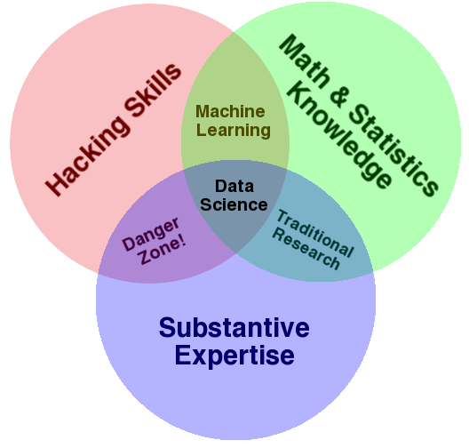
Data Science – A Visual Definition
Notes:
Drew Conway’s definition

Slide 14
Contrast: Databases
 | Databases | Data Science
Data Value | “Precious” | “Cheap”
Data Volume | Modest | Massive
Examples | Bank records, Personnel records, Census, Medical records | Online clicks, GPS logs, Tweets, Building sensor readings
Priorities | Consistency, Error recovery, Auditability | Speed, Availability, Query richness
Structured | Strongly (Schema) | Weakly or none (Text)
Properties | Transactions, ACID* | CAP* theorem (2/3), eventual consistency
Realizations | SQL | NoSQL: MongoDB, CouchDB, Hbase, Cassandra, Riak, Memcached, Apache River, …
ACID = Atomicity, Consistency, Isolation and Durability
CAP = Consistency, Availability, Partition Tolerance
Notes:
Key-Value stores (Riak, Memcached), DHTs,
Tuple space (River), Document store (Mongo, Couch),
Column stores (Hbase, Cassandra)

Slide 15

Contrast: Business Intelligence
Business Intelligence | Data Science
Querying the past | Querying the past present and future
Notes:
Querying the future:
What happens if I show this ad?
Or recommend this product?
Or filter this email?
Microsoft lost an estimated $1.7B on Surface computers (past) but what do they expect to make in future?

Slide 16
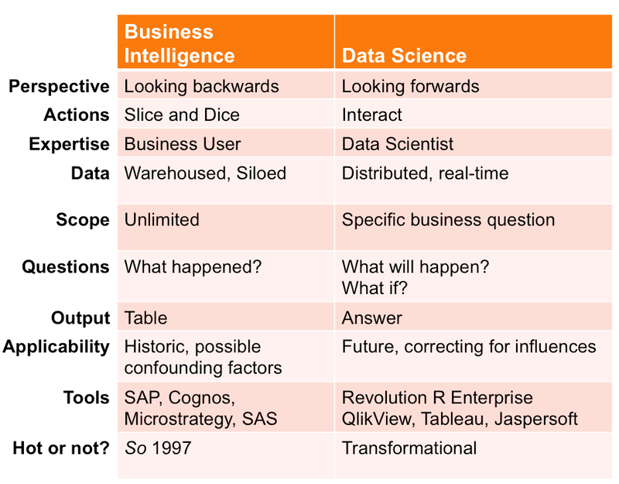

Slide 17
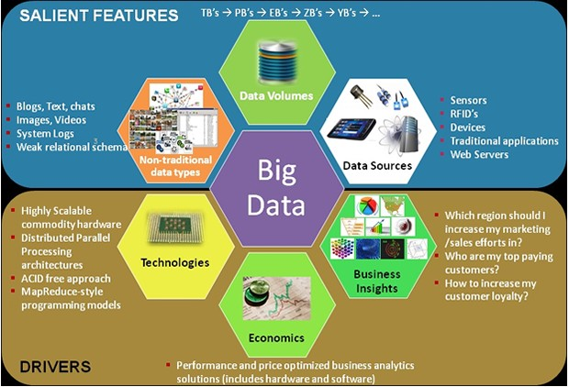

Slide 18
Examples of Big Data Analytics
Using Big Data to win elections
Big Data for finding a perfect match(Matrimony.com)
Big Data for detecting water leakages(Bangalore Water supply and sewage system)
Big Data for gaining insights into shopping behavior

Slide 19
Examples of Big Data Analytics
Big Data for ensuring proper water supply(Kerala Water Supply System)
Using Big Data to improve India’s financial inclusion ratio(Micro-finance firm, Janalakshmi Financial Services)
Using Big Data to improve product development(Reliance Games)
Using Big Data to predict ticket confirmations for trains(PNR prediction)

Slide 20
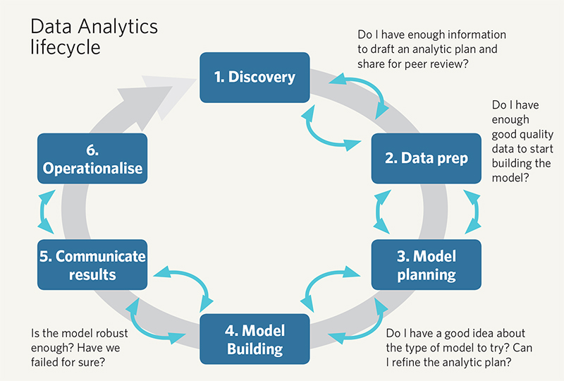

Slide 21
Data Modeling Tools
PowerDesigner
ER/Studio
Sparx Enterprise Architect
Oracle SQL Developer Data Modeler
CA Erwin
IBM - InfoSphere Data Architect
MagicDraw

Slide 22
Contrast: Machine Learning
Machine Learning
Develop new (individual) models
Prove mathematical properties of models
Improve/validate on a few, relatively clean, small datasets
Publish a paper
Data Science
Explore many models, build and tune hybrids
Understand empirical properties of models
Develop/use tools that can handle massive datasets
Take action!
Notes:
CASP - Critical Assessment of protein Structure Prediction

Slide 23
Traditional Programming
Machine Learning
Data
Computer
Output
Program
Data
Computer
Program
Output

Slide 24
AI And Machine Learning Use Cases
Data Security
Personal Security
Healthcare
Financial Trading
Marketing Personalization
Fraud Detection
Recommendations
Online Search
Natural Language Processing (NLP)
Smart Cars

Slide 25

Magic?
No, more like gardening
Seeds = Algorithms
Nutrients = Data
Gardener = You
Plants = Programs

Slide 26
ML in a Nutshell
Tens of thousands of machine learning algorithms
Hundreds new every year
Every machine learning algorithm has three components:
Representation
Evaluation
Optimization

Slide 27
What is machine learning?
A branch of artificial intelligence, concerned with the design and development of algorithms that allow computers to evolve behaviors based on empirical data.
As intelligence requires knowledge, it is necessary for the computers to acquire knowledge.

Slide 28
Sample Applications
Web search
Computational biology
Finance
E-commerce
Space exploration
Robotics
Information extraction
Social networks
Debugging
[Your favorite area]

Slide 29
Applications
Face detection
Object detection and recognition
Image segmentation
Multimedia event detection
Economical and commercial usage

Slide 30
Learning system model
Testing
Input Samples
Learning Method
System
Training

Slide 31
Descriptive Statistics
Descriptive statistics are numbers that are used to summarize and describe data.
The word "data" refers to the information that has been collected from an experiment, a survey, a historical record, etc. (By the way, "data" is plural.
One piece of information is called a "datum.")
If we are analyzing birth certificates, for example, a descriptive statistic might be the percentage of certificates issued in New York State, or the average age of the mother.

Slide 32
Descriptive Statistics
Average salaries for various occupations in 1999.
$112,760 | pediatricians
$106,130 | dentists
$100,090 | podiatrists
$ 76,140 | physicists
$ 53,410 | architects
$ 49,720 | school, clinical, and counseling psychologists
$ 47,910 | flight attendants
$ 39,560 | elementary school teachers
$ 38,710 | police officers
$ 18,980 | floral designers

Slide 33
Types of Statistical Variables
Categorical variable: variables than can be put into categories. For example, the category “Toothpaste Brands” might contain the variables Colgate and Aquafresh.
Confounding variable: extra variables that have a hidden effect on your experimental results.
Continuous variable: a variable with infinite number of values, like “time” or “weight”.
Control variable: a factor in an experiment which must be held constant. For example, in an experiment to determine whether light makes plants grow faster, you would have to control for soil quality and water.
Dependent variable: the outcome of an experiment. As you change the independent variable, you watch what happens to the dependent variable.

Slide 34
Types of Statistical Variables
Discrete variable: a variable that can only take on a certain number of values. For example, “number of cars in a parking lot” is discrete because a car park can only hold so many cars.
Independent variable: a variable that is not affected by anything that you, the researcher, does. Usually plotted on the x-axis.
A measurement variable has a number associated with it. It’s an “amount” of something, or a”number” of something.
Nominal variable: another name for categorical variable.
Ordinal variable: similar to a categorical variable, but there is a clear order. For example, income levels of low, middle, and high could be considered ordinal.
Qualitative variable: a broad category for any variable that can’t be counted (i.e. has no numerical value). Nominal and ordinal variables fall under this umbrella term.

Slide 35
Types of Statistical Variables
Quantitative variable: A broad category that includes any variable that can be counted, or has a numerical value associated with it. Examples of variables that fall into this category include discrete variables and ratio variables.
Ratio variables: similar to interval variables, but has a meaningful zero.

Slide 36
Summary Statistics of Numeric Variables
Mean. A measure of central tendency. It is the arithmetic average; the sum divided by the number of cases.
Sum. The sum or total of the values.
Minimum. The smallest value.
Maximum. The largest value.
Range. The difference between the largest and smallest values--the maximum minus the minimum.
Mode. The most frequently occurring value. If several values share the greatest frequency of occurrence, each of them is a mode.

Slide 37
Summary Statistics of Numeric Variables
Median. The value above and below which half the cases fall; the 50th percentile. If there is an even number of cases, the median is the average of the two middle cases when they are sorted in ascending or descending order. The median is a measure of central tendency not sensitive to outlying values--unlike the mean, which can be affected by one or more extremely high or low values.
Percentile. A value that divides cases according to values below which certain percentages fall. For example, the 25th percentile is the value below which 25% of cases fall.

Slide 38
Summary Statistics of Numeric Variables
Standard error. A measure of how much the value of the mean may vary from sample to sample taken from the same distribution. The standard error of the sample mean can be used to estimate a mean value for the population as a whole. In a normal distribution, 95% of the values of the mean should lie in the range of plus and minus two times the standard error from the mean. Additionally, the standard error can be used to roughly compare the observed mean to a hypothesized value of another mean (that is, you can conclude the two values are different if the ratio of the difference to the standard error is less than -2 or greater than +2).
• Variance. This is the sample variance, which is a measure of dispersion around the mean, equal to the sum of squared deviations from the mean divided by one less than the number of cases. The sample variance is measured in units that are the square of those of the variable itself.

Slide 39
Types of Learning
Supervised (inductive) learning
Training data includes desired outputs
Unsupervised learning
Training data does not include desired outputs
Semi-supervised learning
Training data includes a few desired outputs
Reinforcement learning
Rewards from sequence of actions

Slide 40
Algorithms
Supervised learning
Unsupervised learning
Semi-supervised learning

Slide 41
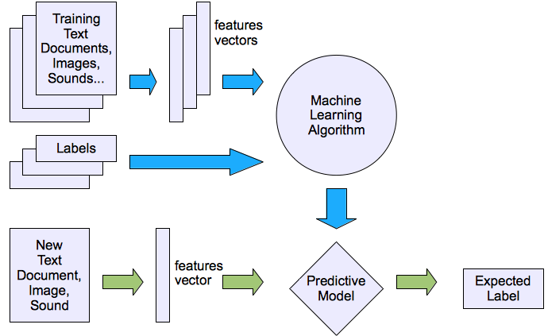
Machine learning structure
Supervised learning

Slide 42
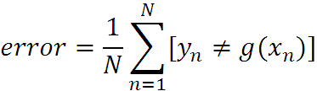
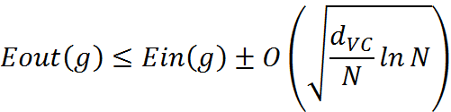
What are we seeking?
Supervised: Low E-out or maximize probabilistic terms
Unsupervised: Minimum quantization error, Minimum distance, MAP, MLE(maximum likelihood estimation)
E-in: for training set
E-out: for testing set

Slide 43




What are we seeking?
Under-fitting VS. Over-fitting (fixed N)
error
(model = hypothesis + loss functions)

Slide 44
Learning techniques
Supervised learning categories and techniques
Linear classifier (numerical functions)
Parametric (Probabilistic functions)
Naïve Bayes, Gaussian discriminant analysis (GDA), Hidden Markov models (HMM), Probabilistic graphical models
Non-parametric (Instance-based functions)
K-nearest neighbors, Kernel regression, Kernel density estimation, Local regression
Non-metric (Symbolic functions)
Classification and regression tree (CART), decision tree
Aggregation
Bagging (bootstrap + aggregation), Adaboost, Random forest

Slide 45

Learning techniques
Linear classifier
Techniques:
Perceptron
Logistic regression
Support vector machine (SVM)
Ada-line
Multi-layer perceptron (MLP)
, where w is an d-dim vector (learned)

Slide 46
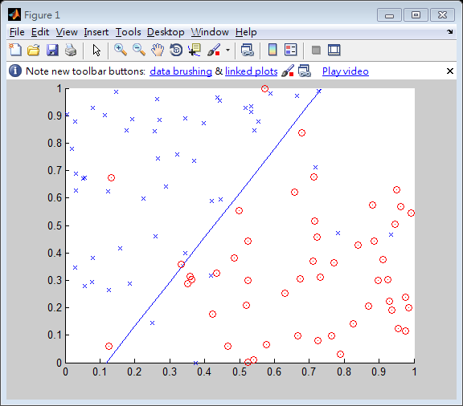
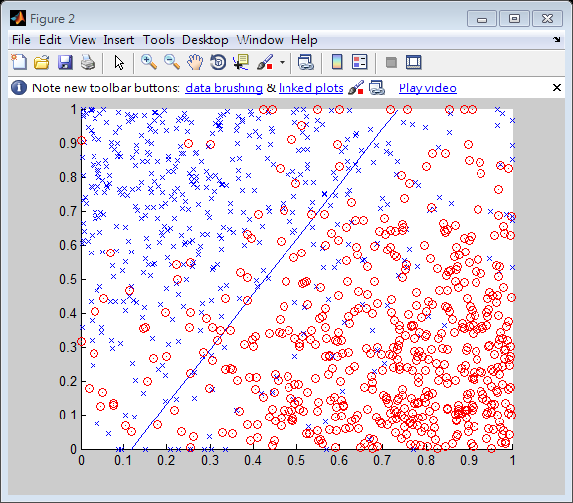
Learning techniques
Using perceptron learning algorithm(PLA)
Training
Testing
Error rate: 0.10
Error rate: 0.156

Slide 47
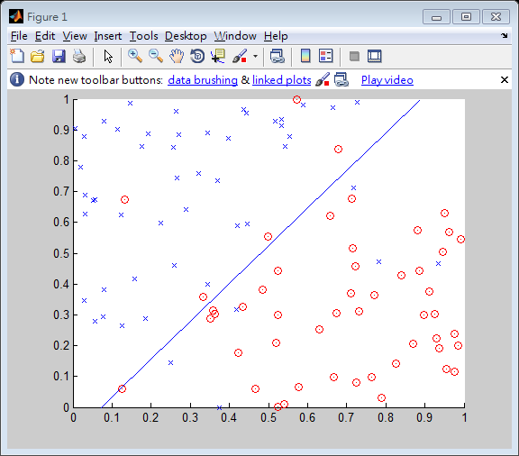
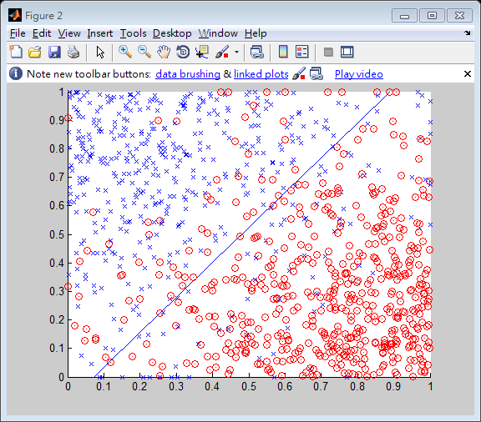
Learning techniques
Using logistic regression
Training
Testing
Error rate: 0.11
Error rate: 0.145

Slide 48



Learning techniques
Non-linear case
Support vector machine (SVM):
Linear to nonlinear: Feature transform and kernel function

Slide 49
Learning techniques
Unsupervised learning categories and techniques
Clustering
K-means clustering
Spectral clustering
Density Estimation
Gaussian mixture model (GMM)
Graphical models
Dimensionality reduction
Principal component analysis (PCA)
Factor analysis

Slide 50
Supervised Learning

Slide 51
An example application
An emergency room in a hospital measures 17 variables (e.g., blood pressure, age, etc) of newly admitted patients.
A decision is needed: whether to put a new patient in an intensive-care unit.
Due to the high cost of ICU, those patients who may survive less than a month are given higher priority.
Problem: to predict high-risk patients and discriminate them from low-risk patients.

Slide 52
Another application
A credit card company receives thousands of applications for new cards. Each application contains information about an applicant,
age
Marital status
annual salary
outstanding debts
credit rating
etc.
Problem: to decide whether an application should approved, or to classify applications into two categories, approved and not approved.

Slide 53
Machine learning and our focus
Like human learning from past experiences.
A computer does not have “experiences”.
A computer system learns from data, which represent some “past experiences” of an application domain.
Our focus: learn a target function that can be used to predict the values of a discrete class attribute, e.g., approve or not-approved, and high-risk or low risk.
The task is commonly called: Supervised learning, classification, or inductive learning.

Slide 54
The data and the goal
Data: A set of data records (also called examples, instances or cases) described by
k attributes: A₁, A₂, … A_{k}.
a class: Each example is labelled with a pre-defined class.
Goal: To learn a classification model from the data that can be used to predict the classes of new (future, or test) cases/instances.
Notes:
Induction is different from deduction and DBMS does not not support induction;
The result of induction is higher-level information or knowledge: general statements about data
There are many approaches. Refer to the lecture notes for CS3244 available at the Co-Op.
We focus on three approaches here, other examples:
Other approaches
Instance-based learning
other neural networks
Concept learning (Version space, Focus, Aq11, …)
Genetic algorithms
Reinforcement learning

Slide 55
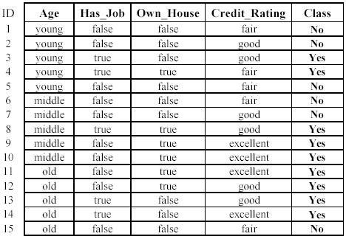
An example: data (loan application)
Approved or not

Slide 56
An example: the learning task
Learn a classification model from the data
Use the model to classify future loan applications into
Yes (approved) and
No (not approved)
What is the class for following case/instance?

Slide 57
Supervised vs. unsupervised Learning
Supervised learning: classification is seen as supervised learning from examples.
Supervision: The data (observations, measurements, etc.) are labeled with pre-defined classes. It is like that a “teacher” gives the classes (supervision).
Test data are classified into these classes too.
Unsupervised learning (clustering)
Class labels of the data are unknown
Given a set of data, the task is to establish the existence of classes or clusters in the data

Slide 58
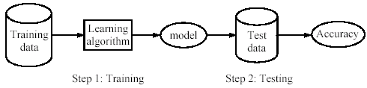
Supervised learning process: two steps
Learning (training): Learn a model using the training data
Testing: Test the model using unseen test data to assess the model accuracy

Slide 59
What do we mean by learning?
Given
a data set D,
a task T, and
a performance measure M,
a computer system is said to learn from D to perform the task T if after learning the system’s performance on T improves as measured by M.
In other words, the learned model helps the system to perform T better as compared to no learning.

Slide 60
An example
Data: Loan application data
Task: Predict whether a loan should be approved or not.
Performance measure: accuracy.
No learning: classify all future applications (test data) to the majority class (i.e., Yes):
Accuracy = 9/15 = 60%.
We can do better than 60% with learning.

Slide 61
Fundamental assumption of learning
Assumption: The distribution of training examples is identical to the distribution of test examples (including future unseen examples).
In practice, this assumption is often violated to certain degree.
Strong violations will clearly result in poor classification accuracy.
To achieve good accuracy on the test data, training examples must be sufficiently representative of the test data.

Slide 62
Introduction
Decision tree learning is one of the most widely used techniques for classification.
Its classification accuracy is competitive with other methods, and
it is very efficient.
The classification model is a tree, called decision tree.
C4.5 by Ross Quinlan is perhaps the best known system. It can be downloaded from the Web.

Slide 63
The loan data (reproduced)
Approved or not

Slide 64
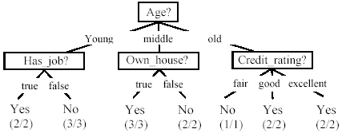
A decision tree from the loan data
Decision nodes and leaf nodes (classes)

Slide 65

Use the decision tree
No

Slide 66
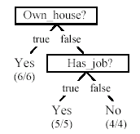
Is the decision tree unique?
No. Here is a simpler tree.
We want smaller tree and accurate tree.
Easy to understand and perform better.
Finding the best tree is NP-hard.
All current tree building algorithms are heuristic algorithms

Slide 67


From a decision tree to a set of rules
A decision tree can be converted to a set of rules
Each path from the root to a leaf is a rule.

Slide 68
Algorithm for decision tree learning
Basic algorithm (a greedy divide-and-conquer algorithm)
Assume attributes are categorical now (continuous attributes can be handled too)
Tree is constructed in a top-down recursive manner
At start, all the training examples are at the root
Examples are partitioned recursively based on selected attributes
Attributes are selected on the basis of an impurity function (e.g., information gain)
Conditions for stopping partitioning
All examples for a given node belong to the same class
There are no remaining attributes for further partitioning – majority class is the leaf
There are no examples left

Slide 69
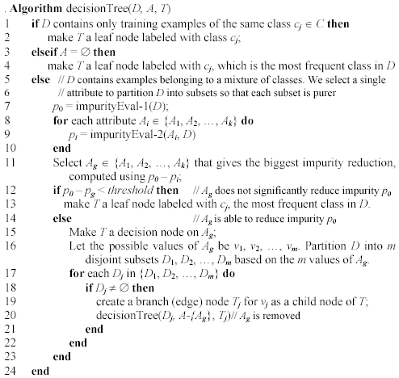
Decision tree learning algorithm

Slide 70
Choose an attribute to partition data
The key to building a decision tree - which attribute to choose in order to branch.
The objective is to reduce impurity or uncertainty in data as much as possible.
A subset of data is pure if all instances belong to the same class.
The heuristic in C4.5 is to choose the attribute with the maximum Information Gain or Gain Ratio based on information theory.

Slide 71
The loan data (reproduced)
Approved or not

Slide 72
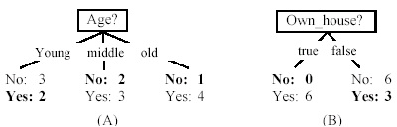
Two possible roots, which is better?
Fig. (B) seems to be better.

Slide 73
Information theory
Information theory provides a mathematical basis for measuring the information content.
To understand the notion of information, think about it as providing the answer to a question, for example, whether a coin will come up heads.
If one already has a good guess about the answer, then the actual answer is less informative.
If one already knows that the coin is rigged so that it will come with heads with probability 0.99, then a message (advanced information) about the actual outcome of a flip is worth less than it would be for a honest coin (50-50).

Slide 74
Information theory (cont …)
For a fair (honest) coin, you have no information, and you are willing to pay more (say in terms of $) for advanced information - less you know, the more valuable the information.
Information theory uses this same intuition, but instead of measuring the value for information in dollars, it measures information contents in bits.
One bit of information is enough to answer a yes/no question about which one has no idea, such as the flip of a fair coin

Slide 75
Information theory: Entropy measure
The entropy formula,
Pr(c_{j}) is the probability of class c_{j} in data set D
We use entropy as a measure of impurity or disorder of data set D. (Or, a measure of information in a tree)

Slide 76
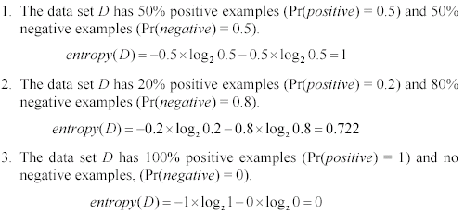
Entropy measure: let us get a feeling
As the data become purer and purer, the entropy value becomes smaller and smaller. This is useful to us!

Slide 77

Information gain
Given a set of examples D, we first compute its entropy:
If we make attribute A_{i}, with v values, the root of the current tree, this will partition D into v subsets D₁, D₂ …, D_{v} . The expected entropy if A_{i} is used as the current root:

Slide 78
Information gain (cont …)
Information gained by selecting attribute A_{i} to branch or to partition the data is
We choose the attribute with the highest gain to branch/split the current tree.

Slide 79
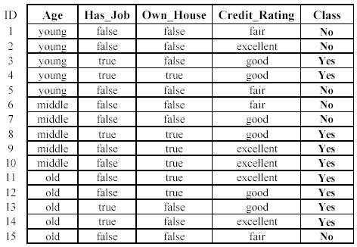

An example
Own_house is the best choice for the root.

Slide 80
We build the final tree
We can use information gain ratio to evaluate the impurity as well (see the handout)

Slide 81
Handling continuous attributes
Handle continuous attribute by splitting into two intervals (can be more) at each node.
How to find the best threshold to divide?
Use information gain or gain ratio again
Sort all the values of an continuous attribute in increasing order {v₁, v₂, …, v_{r}},
One possible threshold between two adjacent values v_{i} and v_{i+1}. Try all possible thresholds and find the one that maximizes the gain (or gain ratio).

Slide 82
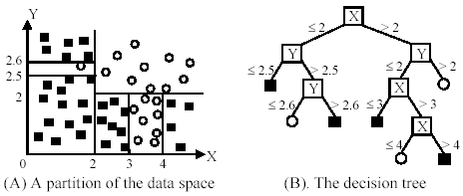
An example in a continuous space

Slide 83
Avoid overfitting in classification
Overfitting: A tree may overfit the training data
Good accuracy on training data but poor on test data
Symptoms: tree too deep and too many branches, some may reflect anomalies due to noise or outliers
Two approaches to avoid overfitting
Pre-pruning: Halt tree construction early
Difficult to decide because we do not know what may happen subsequently if we keep growing the tree.
Post-pruning: Remove branches or sub-trees from a “fully grown” tree.
This method is commonly used. C4.5 uses a statistical method to estimates the errors at each node for pruning.
A validation set may be used for pruning as well.

Slide 84
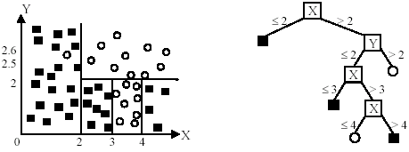
An example
Likely to overfit the data

Slide 85
Other issues in decision tree learning
From tree to rules, and rule pruning
Handling of miss values
Handing skewed distributions
Handling attributes and classes with different costs.
Attribute construction
Etc.

Slide 86
Supervised learning vs. unsupervised learning
Supervised learning: discover patterns in the data that relate data attributes with a target (class) attribute.
These patterns are then utilized to predict the values of the target attribute in future data instances.
Unsupervised learning: The data have no target attribute.
We want to explore the data to find some intrinsic structures in them.

Slide 87
Clustering
Clustering is a technique for finding similarity groups in data, called clusters. I.e.,
it groups data instances that are similar to (near) each other in one cluster and data instances that are very different (far away) from each other into different clusters.
Clustering is often called an unsupervised learning task as no class values denoting an a priori grouping of the data instances are given, which is the case in supervised learning.
Due to historical reasons, clustering is often considered synonymous with unsupervised learning.
In fact, association rule mining is also unsupervised
This chapter focuses on clustering.

Slide 88
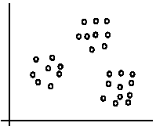
An illustration
The data set has three natural groups of data points, i.e., 3 natural clusters.

Slide 89
What is clustering for?
Let us see some real-life examples
Example 1: groups people of similar sizes together to make “small”, “medium” and “large” T-Shirts.
Tailor-made for each person: too expensive
One-size-fits-all: does not fit all.
Example 2: In marketing, segment customers according to their similarities
To do targeted marketing.

Slide 90
What is clustering for? (cont…)
Example 3: Given a collection of text documents, we want to organize them according to their content similarities,
To produce a topic hierarchy
In fact, clustering is one of the most utilized data mining techniques.
It has a long history, and used in almost every field, e.g., medicine, psychology, botany, sociology, biology, archeology, marketing, insurance, libraries, etc.
In recent years, due to the rapid increase of online documents, text clustering becomes important.

Slide 91
Aspects of clustering
A clustering algorithm
Partitional clustering
Hierarchical clustering
…
A distance (similarity, or dissimilarity) function
Clustering quality
Inter-clusters distance ⇒ maximized
Intra-clusters distance ⇒ minimized
The quality of a clustering result depends on the algorithm, the distance function, and the application.

Slide 92
Road map
Basic concepts
K-means algorithm
Representation of clusters
Hierarchical clustering
Distance functions
Data standardization
Handling mixed attributes
Which clustering algorithm to use?
Cluster evaluation
Discovering holes and data regions
Summary

Slide 93
K-means clustering
K-means is a partitional clustering algorithm
Let the set of data points (or instances) D be
{x₁, x₂, …, x_{n}},
where x_{i} = (x_{i1}, x_{i2}, …, x_{ir}) is a vector in a real-valued space X ⊆ R^{r}, and r is the number of attributes (dimensions) in the data.
The k-means algorithm partitions the given data into k clusters.
Each cluster has a cluster center, called centroid.
k is specified by the user

Slide 94
K-means algorithm
Given k, the k-means algorithm works as follows:
Randomly choose k data points (seeds) to be the initial centroids, cluster centers
Assign each data point to the closest centroid
Re-compute the centroids using the current cluster memberships.
If a convergence criterion is not met, go to 2).

Slide 95
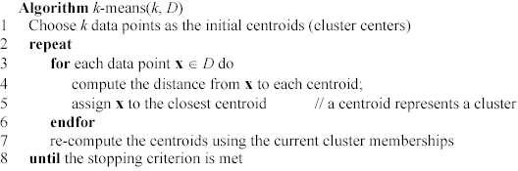
K-means algorithm – (cont …)

Slide 96
Stopping/convergence criterion
no (or minimum) re-assignments of data points to different clusters,
no (or minimum) change of centroids, or
minimum decrease in the sum of squared error (SSE),
C_{i} is the jth cluster, m_{j} is the centroid of cluster C_{j} (the mean vector of all the data points in C_{j}), and dist(x, m_{j}) is the distance between data point x and centroid m_{j}.
(1)

Slide 97
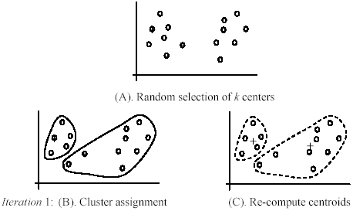
An example
+
+

Slide 98
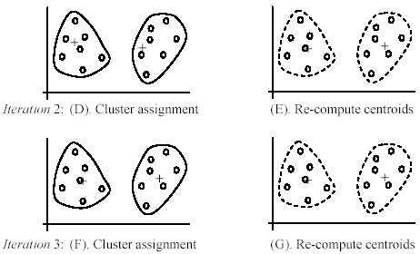
An example (cont …)

Slide 99
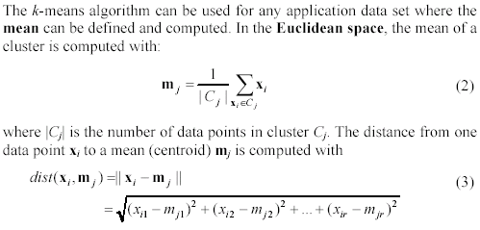
An example distance function

Slide 100
A disk version of k-means
K-means can be implemented with data on disk
In each iteration, it scans the data once.
as the centroids can be computed incrementally
It can be used to cluster large datasets that do not fit in main memory
We need to control the number of iterations
In practice, a limited is set (< 50).
Not the best method. There are other scale-up algorithms, e.g., BIRCH.

Slide 101
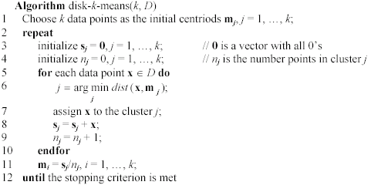
A disk version of k-means (cont …)

Slide 102
Strengths of k-means
Strengths:
Simple: easy to understand and to implement
Efficient: Time complexity: O(tkn),
where n is the number of data points,
k is the number of clusters, and
t is the number of iterations.
Since both k and t are small. k-means is considered a linear algorithm.
K-means is the most popular clustering algorithm.
Note that: it terminates at a local optimum if SSE is used. The global optimum is hard to find due to complexity.

Slide 103
Weaknesses of k-means
The algorithm is only applicable if the mean is defined.
For categorical data, k-mode - the centroid is represented by most frequent values.
The user needs to specify k.
The algorithm is sensitive to outliers
Outliers are data points that are very far away from other data points.
Outliers could be errors in the data recording or some special data points with very different values.

Slide 104
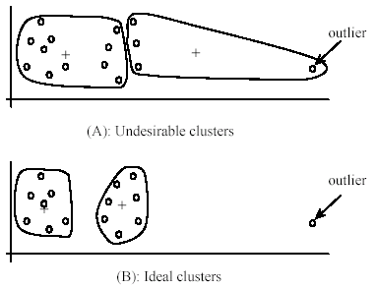
Weaknesses of k-means: Problems with outliers

Slide 105
Weaknesses of k-means: To deal with outliers
One method is to remove some data points in the clustering process that are much further away from the centroids than other data points.
To be safe, we may want to monitor these possible outliers over a few iterations and then decide to remove them.
Another method is to perform random sampling. Since in sampling we only choose a small subset of the data points, the chance of selecting an outlier is very small.
Assign the rest of the data points to the clusters by distance or similarity comparison, or classification

Slide 106
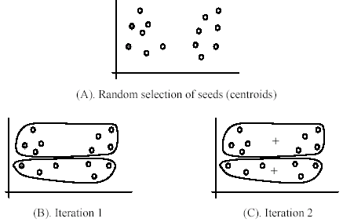
Weaknesses of k-means (cont …)
The algorithm is sensitive to initial seeds.

Slide 107
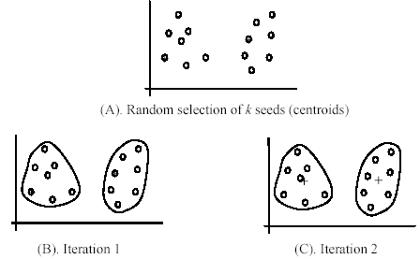
Weaknesses of k-means (cont …)
If we use different seeds: good results
There are some methods to help choose good seeds

Slide 108
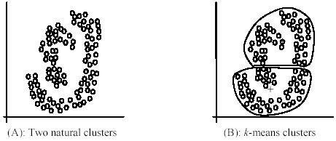
Weaknesses of k-means (cont …)
The k-means algorithm is not suitable for discovering clusters that are not hyper-ellipsoids (or hyper-spheres).
+

Slide 109
K-means summary
Despite weaknesses, k-means is still the most popular algorithm due to its simplicity, efficiency and
other clustering algorithms have their own lists of weaknesses.
No clear evidence that any other clustering algorithm performs better in general
although they may be more suitable for some specific types of data or applications.
Comparing different clustering algorithms is a difficult task. No one knows the correct clusters!

Slide 110
Road map
Basic concepts
K-means algorithm
Representation of clusters
Hierarchical clustering
Distance functions
Data standardization
Handling mixed attributes
Which clustering algorithm to use?
Cluster evaluation
Discovering holes and data regions
Summary

Slide 111
Common ways to represent clusters
Use the centroid of each cluster to represent the cluster.
compute the radius and
standard deviation of the cluster to determine its spread in each dimension
The centroid representation alone works well if the clusters are of the hyper-spherical shape.
If clusters are elongated or are of other shapes, centroids are not sufficient

Slide 112
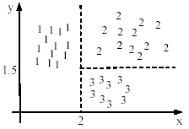

Using classification model
All the data points in a cluster are regarded to have the same class label, e.g., the cluster ID.
run a supervised learning algorithm on the data to find a classification model.

Slide 113
Use frequent values to represent cluster
This method is mainly for clustering of categorical data (e.g., k-modes clustering).
Main method used in text clustering, where a small set of frequent words in each cluster is selected to represent the cluster.

Slide 114
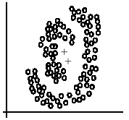
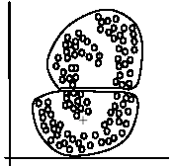
Clusters of arbitrary shapes
Hyper-elliptical and hyper-spherical clusters are usually easy to represent, using their centroid together with spreads.
Irregular shape clusters are hard to represent. They may not be useful in some applications.
Using centroids are not suitable (upper figure) in general
K-means clusters may be more useful (lower figure), e.g., for making 2 size T-shirts.

Slide 115
Road map
Basic concepts
K-means algorithm
Representation of clusters
Hierarchical clustering
Distance functions
Data standardization
Handling mixed attributes
Which clustering algorithm to use?
Cluster evaluation
Discovering holes and data regions
Summary

Slide 116
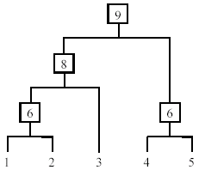
Hierarchical Clustering
Produce a nested sequence of clusters, a tree, also called Dendrogram.

Slide 117
Types of hierarchical clustering
Agglomerative (bottom up) clustering: It builds the dendrogram (tree) from the bottom level, and
merges the most similar (or nearest) pair of clusters
stops when all the data points are merged into a single cluster (i.e., the root cluster).
Divisive (top down) clustering: It starts with all data points in one cluster, the root.
Splits the root into a set of child clusters. Each child cluster is recursively divided further
stops when only singleton clusters of individual data points remain, i.e., each cluster with only a single point

Slide 118
Agglomerative clustering
It is more popular then divisive methods.
At the beginning, each data point forms a cluster (also called a node).
Merge nodes/clusters that have the least distance.
Go on merging
Eventually all nodes belong to one cluster

Slide 119
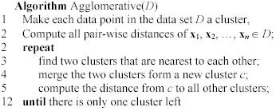
Agglomerative clustering algorithm

Slide 120
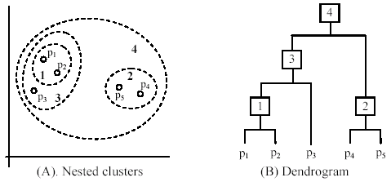
An example: working of the algorithm

Slide 121
Measuring the distance of two clusters
A few ways to measure distances of two clusters.
Results in different variations of the algorithm.
Single link
Complete link
Average link
Centroids
…

Slide 122
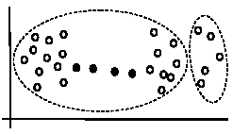
Single link method
The distance between two clusters is the distance between two closest data points in the two clusters, one data point from each cluster.
It can find arbitrarily shaped clusters, but
It may cause the undesirable “chain effect” by noisy points
Two natural clusters are split into two

Slide 123
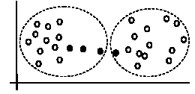
Complete link method
The distance between two clusters is the distance of two furthest data points in the two clusters.
It is sensitive to outliers because they are far away

Slide 124
Average link and centroid methods
Average link: A compromise between
the sensitivity of complete-link clustering to outliers and
the tendency of single-link clustering to form long chains that do not correspond to the intuitive notion of clusters as compact, spherical objects.
In this method, the distance between two clusters is the average distance of all pair-wise distances between the data points in two clusters.
Centroid method: In this method, the distance between two clusters is the distance between their centroids

Slide 125
The complexity
All the algorithms are at least O(n²). n is the number of data points.
Single link can be done in O(n²).
Complete and average links can be done in O(n²logn).
Due the complexity, hard to use for large data sets.
Sampling
Scale-up methods (e.g., BIRCH).

Slide 126
Road map
Basic concepts
K-means algorithm
Representation of clusters
Hierarchical clustering
Distance functions
Data standardization
Handling mixed attributes
Which clustering algorithm to use?
Cluster evaluation
Discovering holes and data regions
Summary

Slide 127
Distance functions
Key to clustering. “similarity” and “dissimilarity” can also commonly used terms.
There are numerous distance functions for
Different types of data
Numeric data
Nominal data
Different specific applications

Slide 128
Distance functions for numeric attributes
Most commonly used functions are
Euclidean distance and
Manhattan (city block) distance
We denote distance with: dist(x_{i}, x_{j}), where x_{i} and x_{j} are data points (vectors)
They are special cases of Minkowski distance. h is positive integer.

Slide 129
Euclidean distance and Manhattan distance
If h = 2, it is the Euclidean distance
If h = 1, it is the Manhattan distance
Weighted Euclidean distance

Slide 130
Squared distance and Chebychev distance
Squared Euclidean distance: to place progressively greater weight on data points that are further apart.
Chebychev distance: one wants to define two data points as "different" if they are different on any one of the attributes.

Slide 131
Distance functions for binary and nominal attributes
Binary attribute: has two values or states but no ordering relationships, e.g.,
Gender: male and female.
We use a confusion matrix to introduce the distance functions/measures.
Let the ith and jth data points be x_{i} and x_{j} (vectors)

Slide 132
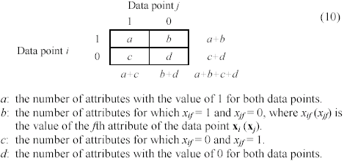
Confusion matrix

Slide 133
Symmetric binary attributes
A binary attribute is symmetric if both of its states (0 and 1) have equal importance, and carry the same weights, e.g., male and female of the attribute Gender
Distance function: Simple Matching Coefficient, proportion of mismatches of their values

Slide 134


Symmetric binary attributes: example

Slide 135
Asymmetric binary attributes
Asymmetric: if one of the states is more important or more valuable than the other.
By convention, state 1 represents the more important state, which is typically the rare or infrequent state.
Jaccard coefficient is a popular measure
We can have some variations, adding weights

Slide 136
Nominal attributes
Nominal attributes: with more than two states or values.
the commonly used distance measure is also based on the simple matching method.
Given two data points x_{i} and x_{j}, let the number of attributes be r, and the number of values that match in x_{i} and x_{j} be q.

Slide 137
Distance function for text documents
A text document consists of a sequence of sentences and each sentence consists of a sequence of words.
To simplify: a document is usually considered a “bag” of words in document clustering.
Sequence and position of words are ignored.
A document is represented with a vector just like a normal data point.
It is common to use similarity to compare two documents rather than distance.
The most commonly used similarity function is the cosine similarity. We will study this later.

Slide 138
Road map
Basic concepts
K-means algorithm
Representation of clusters
Hierarchical clustering
Distance functions
Data standardization
Handling mixed attributes
Which clustering algorithm to use?
Cluster evaluation
Discovering holes and data regions
Summary

Slide 139
Data standardization
In the Euclidean space, standardization of attributes is recommended so that all attributes can have equal impact on the computation of distances.
Consider the following pair of data points
x_{i}: (0.1, 20) and x_{j}: (0.9, 720).
The distance is almost completely dominated by (720-20) = 700.
Standardize attributes: to force the attributes to have a common value range

Slide 140
Interval-scaled attributes
Their values are real numbers following a linear scale.
The difference in Age between 10 and 20 is the same as that between 40 and 50.
The key idea is that intervals keep the same importance through out the scale
Two main approaches to standardize interval scaled attributes, range and z-score. f is an attribute

Slide 141
Interval-scaled attributes (cont …)
Z-score: transforms the attribute values so that they have a mean of zero and a mean absolute deviation of 1. The mean absolute deviation of attribute f, denoted by s_{f}, is computed as follows
Z-score:

Slide 142
Ratio-scaled attributes
Numeric attributes, but unlike interval-scaled attributes, their scales are exponential,
For example, the total amount of microorganisms that evolve in a time t is approximately given by
Ae^{Bt},
where A and B are some positive constants.
Do log transform:
Then treat it as an interval-scaled attribuete

Slide 143
Nominal attributes
Sometime, we need to transform nominal attributes to numeric attributes.
Transform nominal attributes to binary attributes.
The number of values of a nominal attribute is v.
Create v binary attributes to represent them.
If a data instance for the nominal attribute takes a particular value, the value of its binary attribute is set to 1, otherwise it is set to 0.
The resulting binary attributes can be used as numeric attributes, with two values, 0 and 1.

Slide 144
Nominal attributes: an example
Nominal attribute fruit: has three values,
Apple, Orange, and Pear
We create three binary attributes called, Apple, Orange, and Pear in the new data.
If a particular data instance in the original data has Apple as the value for fruit,
then in the transformed data, we set the value of the attribute Apple to 1, and
the values of attributes Orange and Pear to 0

Slide 145
Ordinal attributes
Ordinal attribute: an ordinal attribute is like a nominal attribute, but its values have a numerical ordering. E.g.,
Age attribute with values: Young, MiddleAge and Old. They are ordered.
Common approach to standardization: treat is as an interval-scaled attribute.

Slide 146
Road map
Basic concepts
K-means algorithm
Representation of clusters
Hierarchical clustering
Distance functions
Data standardization
Handling mixed attributes
Which clustering algorithm to use?
Cluster evaluation
Discovering holes and data regions
Summary

Slide 147
Mixed attributes
Our distance functions given are for data with all numeric attributes, or all nominal attributes, etc.
Practical data has different types:
Any subset of the 6 types of attributes,
interval-scaled,
symmetric binary,
asymmetric binary,
ratio-scaled,
ordinal and
nominal

Slide 148
Convert to a single type
One common way of dealing with mixed attributes is to
Decide the dominant attribute type, and
Convert the other types to this type.
E.g, if most attributes in a data set are interval-scaled,
we convert ordinal attributes and ratio-scaled attributes to interval-scaled attributes.
It is also appropriate to treat symmetric binary attributes as interval-scaled attributes.

Slide 149
Convert to a single type (cont …)
It does not make much sense to convert a nominal attribute or an asymmetric binary attribute to an interval-scaled attribute,
but it is still frequently done in practice by assigning some numbers to them according to some hidden ordering, e.g., prices of the fruits
Alternatively, a nominal attribute can be converted to a set of (symmetric) binary attributes, which are then treated as numeric attributes.

Slide 150
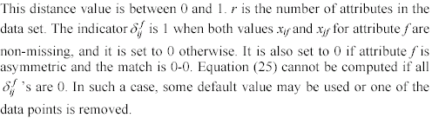
Combining individual distances
This approach computes individual attribute distances and then combine them.

Slide 151
Road map
Basic concepts
K-means algorithm
Representation of clusters
Hierarchical clustering
Distance functions
Data standardization
Handling mixed attributes
Which clustering algorithm to use?
Cluster evaluation
Discovering holes and data regions
Summary

Slide 152
How to choose a clustering algorithm
Clustering research has a long history. A vast collection of algorithms are available.
We only introduced several main algorithms.
Choosing the “best” algorithm is a challenge.
Every algorithm has limitations and works well with certain data distributions.
It is very hard, if not impossible, to know what distribution the application data follow. The data may not fully follow any “ideal” structure or distribution required by the algorithms.
One also needs to decide how to standardize the data, to choose a suitable distance function and to select other parameter values.

Slide 153
Choose a clustering algorithm (cont …)
Due to these complexities, the common practice is to
run several algorithms using different distance functions and parameter settings, and
then carefully analyze and compare the results.
The interpretation of the results must be based on insight into the meaning of the original data together with knowledge of the algorithms used.
Clustering is highly application dependent and to certain extent subjective (personal preferences).

Slide 154
Road map
Basic concepts
K-means algorithm
Representation of clusters
Hierarchical clustering
Distance functions
Data standardization
Handling mixed attributes
Which clustering algorithm to use?
Cluster evaluation
Discovering holes and data regions
Summary

Slide 155
Cluster Evaluation: hard problem
The quality of a clustering is very hard to evaluate because
We do not know the correct clusters
Some methods are used:
User inspection
Study centroids, and spreads
Rules from a decision tree.
For text documents, one can read some documents in clusters.

Slide 156
Cluster evaluation: ground truth
We use some labeled data (for classification)
Assumption: Each class is a cluster.
After clustering, a confusion matrix is constructed. From the matrix, we compute various measurements, entropy, purity, precision, recall and F-score.
Let the classes in the data D be C = (c₁, c₂, …, c_{k}). The clustering method produces k clusters, which divides D into k disjoint subsets, D₁, D₂, …, D_{k}.

Slide 157
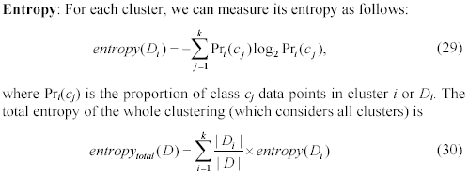
Evaluation measures: Entropy

Slide 158
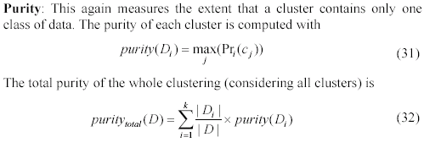
Evaluation measures: purity

Slide 159
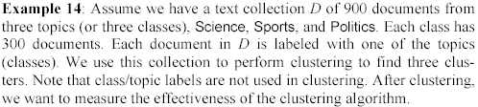
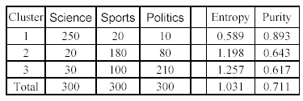
An example

Slide 160
A remark about ground truth evaluation
Commonly used to compare different clustering algorithms.
A real-life data set for clustering has no class labels.
Thus although an algorithm may perform very well on some labeled data sets, no guarantee that it will perform well on the actual application data at hand.
The fact that it performs well on some label data sets does give us some confidence of the quality of the algorithm.
This evaluation method is said to be based on external data or information.

Slide 161
Evaluation based on internal information
Intra-cluster cohesion (compactness):
Cohesion measures how near the data points in a cluster are to the cluster centroid.
Sum of squared error (SSE) is a commonly used measure.
Inter-cluster separation (isolation):
Separation means that different cluster centroids should be far away from one another.
In most applications, expert judgments are still the key.

Slide 162
Indirect evaluation
In some applications, clustering is not the primary task, but used to help perform another task.
We can use the performance on the primary task to compare clustering methods.
For instance, in an application, the primary task is to provide recommendations on book purchasing to online shoppers.
If we can cluster books according to their features, we might be able to provide better recommendations.
We can evaluate different clustering algorithms based on how well they help with the recommendation task.
Here, we assume that the recommendation can be reliably evaluated.

Slide 163
Road map
Basic concepts
K-means algorithm
Representation of clusters
Hierarchical clustering
Distance functions
Data standardization
Handling mixed attributes
Which clustering algorithm to use?
Cluster evaluation
Discovering holes and data regions
Summary

Slide 164
Holes in data space
All the clustering algorithms only group data.
Clusters only represent one aspect of the knowledge in the data.
Another aspect that we have not studied is the holes.
A hole is a region in the data space that contains no or few data points. Reasons:
insufficient data in certain areas, and/or
certain attribute-value combinations are not possible or seldom occur.

Slide 165
Holes are useful too
Although clusters are important, holes in the space can be quite useful too.
For example, in a disease database
we may find that certain symptoms and/or test values do not occur together, or
when a certain medicine is used, some test values never go beyond certain ranges.
Discovery of such information can be important in medical domains because
it could mean the discovery of a cure to a disease or some biological laws.

Slide 166
Data regions and empty regions
Given a data space, separate
data regions (clusters) and
empty regions (holes, with few or no data points).
Use a supervised learning technique, i.e., decision tree induction, to separate the two types of regions.
Due to the use of a supervised learning method for an unsupervised learning task,
an interesting connection is made between the two types of learning paradigms.

Slide 167
Supervised learning for unsupervised learning
Decision tree algorithm is not directly applicable.
it needs at least two classes of data.
A clustering data set has no class label for each data point.
The problem can be dealt with by a simple idea.
Regard each point in the data set to have a class label Y.
Assume that the data space is uniformly distributed with another type of points, called non-existing points. We give them the class, N.
With the N points added, the problem of partitioning the data space into data and empty regions becomes a supervised classification problem.

Slide 168
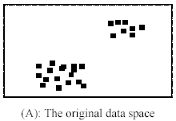
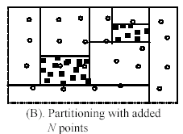
An example
A decision tree method is used for partitioning in (B).

Slide 169
Can it done without adding N points?
Yes.
Physically adding N points increases the size of the data and thus the running time.
More importantly: it is unlikely that we can have points truly uniformly distributed in a high dimensional space as we would need an exponential number of points.
Fortunately, no need to physically add any N points.
We can compute them when needed

Slide 170
Characteristics of the approach
It provides representations of the resulting data and empty regions in terms of hyper-rectangles, or rules.
It detects outliers automatically. Outliers are data points in an empty region.
It may not use all attributes in the data just as in a normal decision tree for supervised learning.
It can automatically determine what attributes are useful. Subspace clustering …
Drawback: data regions of irregular shapes are hard to handle since decision tree learning only generates hyper-rectangles (formed by axis-parallel hyper-planes), which are rules.

Slide 171
Building the Tree
The main computation in decision tree building is to evaluate entropy (for information gain):
Can it be evaluated without adding N points? Yes.
Pr(c_{j}) is the probability of class c_{j} in data set D, and |C| is the number of classes, Y and N (2 classes).
To compute Pr(c_{j}), we only need the number of Y (data) points and the number of N (non-existing) points.
We already have Y (or data) points, and we can compute the number of N points on the fly. Simple: as we assume that the N points are uniformly distributed in the space.

Slide 172
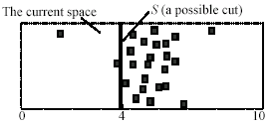
An example
The space has 25 data (Y) points and 25 N points. Assume the system is evaluating a possible cut S.
# N points on the left of S is 25 * 4/10 = 10. The number of Y points is 3.
Likewise, # N points on the right of S is 15 (= 25 - 10).The number of Y points is 22.
With these numbers, entropy can be computed.

Slide 173

How many N points to add?
We add a different number of N points at each different node.
The number of N points for the current node E is determined by the following rule (note that at the root node, the number of inherited N points is 0):

Slide 174
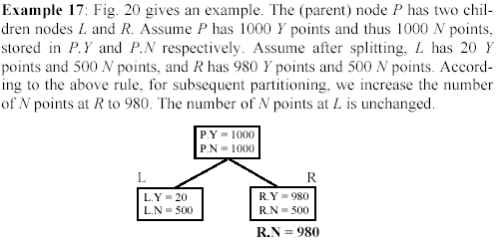
An example

Slide 175
How many N points to add? (cont…)
Basically, for a Y node (which has more data points), we increase N points so that
#Y = #N
The number of N points is not reduced if the current node is an N node (an N node has more N points than Y points).
A reduction may cause outlier Y points to form Y nodes (a Y node has an equal number of Y points as N points or more).
Then data regions and empty regions may not be separated well.

Slide 176
Building the decision tree
Using the above ideas, a decision tree can be built to separate data regions and empty regions.
The actual method is more sophisticated as a few other tricky issues need to be handled in
tree building and
tree pruning.

Slide 177
Road map
Basic concepts
K-means algorithm
Representation of clusters
Hierarchical clustering
Distance functions
Data standardization
Handling mixed attributes
Which clustering algorithm to use?
Cluster evaluation
Discovering holes and data regions
Summary

Slide 178
Summary
Clustering is has along history and still active
There are a huge number of clustering algorithms
More are still coming every year.
We only introduced several main algorithms. There are many others, e.g.,
density based algorithm, sub-space clustering, scale-up methods, neural networks based methods, fuzzy clustering, co-clustering, etc.
Clustering is hard to evaluate, but very useful in practice. This partially explains why there are still a large number of clustering algorithms being devised every year.
Clustering is highly application dependent and to some extent subjective.

Slide 179
Conclusion
We have a simple overview of some techniques and algorithms in machine learning. Furthermore, there are more and more techniques apply machine learning as a solution. In the future, machine learning will play an important role in our daily life.

